Slide 1
macro vs. micro
Gender
Name
Bar State
Birthday
Sex
Education
Birthday
Specialty
Education
City
Work History
Groups
Name
Language
consumer
bar association
patient
Age 43
Contact lens
Type 2 Diabetes
3 Children- ages: 5, 4, 1
Classes
Gay or Straight
Blondes
AXA PPP Healthcare
Exact Residence
Iced Soy Latte
Blood Type AB
5’10”
introvert
Celtics Fan
Dark Chocolate
Medical history
200 lbs.
Academic interests
Right-handed
Penicillin allergy
Closest business colleagues
Surgical history
Friends at MIT
Favorite Bars
1

Slide 2

PRODUCT DESIGN
PRODUCT MANAGEMENT
10 PLUS YEARS,
UX DESIGN & MANAGEMENT
STRATEGIC PLANNING
PRODUCT STRATEGY
PRODUCT DEVELOPMENT
IN PRODUCT & DESIGN.
(MOBILE & WEB.)
NEXT ROLE?
Def.
Design – the art of making ideas awesome.
Product – the ability to keep ideas awesome.
Management – the skill to handle multiple activities.
2

Slide 3
3C’S: Content, Community & Communications
Are central to social and the product experience. By integrating the right mix of features across products and the ability to share and save meaningful moments, you create relevancy and meaning.
CENTRAL TO MY
WORK ARE THE 3C’S,
I LEARNED AT YAHOO.
Email
Messenger
SMS/MMS
VOIP
360
Presence
Blogging
Buddy Radar
Def.
Storage
&
Integration
Integration - linking all applications together
Storage - for all types of personal “objects”
Photos
Infotainment
Marketplace
Search
Content
Community
Communications
3

Slide 4
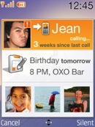
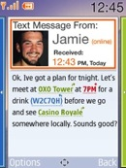
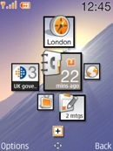
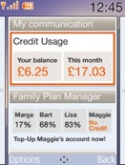
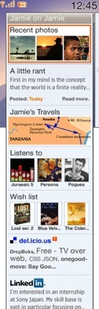
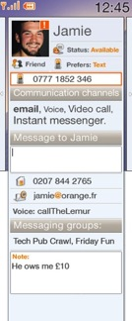
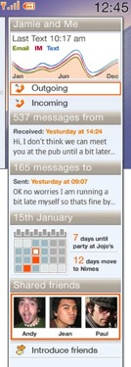
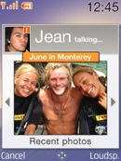
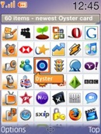
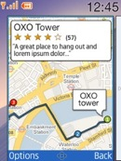
in-cal
friend updates
enriched
messaging
tag cloud
homescreen
my orange
account
social
address book
multiplatform
contacts book
contacts
timeline
MOBILE IS WAY
BETTER WHEN THE
SERVICES ARE SOCIAL
private
location
sharing
content
sharing
mobile
advertising
apps
ecosystem
Def.
FOX DNA – Core services based on the Yahoo 3C’s
FOX Premise – 100M subscribers equal to 100M activations; global network of towers equal to a T1; and a database of subscribers with billing information and social behavior is ripe for data mining.
Storage & Integration
Content
Social
Graphing
Carrier
Billing
Community
Communications
T
Cloud
Services
4

Slide 5

AND HERE
1. FOX roared , but not everyone embraced it – business politics, competing projects & budgets
4. I then brought the projects together later to launch a v1 proposition with funding
TO GET BUYIN
£42K, Dec 06
£40K, Dec 07
FOX
2. So I disguised the concept, breaking it apart, and aligning it to current workstreams
I HAD TO “VOLTRON”
THE DELIVERY (SEE)
concept, user
journeys, demo
The Goal
FOX v1
Orange
Address Book
£35K, Mar 07
HERE
concept,
usecases, wireframes
Def.
£32K, Apr 07
3. To maintain the vision, I used a global set of requirements to manage the work
Messaging
& IM Chat
Voltron – An anime of the 80’s in which the teams vehicles join together to form a giant super robot and defend the universe.
usecases,
wireframes, product spec
Content
Sharing (via IMS)
£30K, Apr 07
IP Multimedia Services Ongoing to 08
usecases,
position paper
Oct
06
Sep
07
Dec
07
5

Slide 6
INNOVATION PROCESS / BOOTSTRAP
ANALYZE
User Research
Business Objectives
Market Trends
Technology Blogs
Consumer insights
IDENTIFY
User Profiles
User Requirements
Business Needs
UX Principles
Proposition
Project Sponsors
EXPLORE
Initial Requirements
Storyboards
User Journeys
Interaction Flows
Mockups
Demo or Prototype
REFINE
User Testing
Org Feedback
Engage SMEs
Technical Feasibility
CONCEPT
Product Description
Resource Planning
Technical Review
Costs & Demo
Sponsorship
WITH NEW
IDEAS I NORMALLY
START LIKE THIS
analysis
synthesis
communication
User
Profiles
Device
Proposition
CONCEPT BRIEF
PRODUCT
CHARTER
Market
Trends &
Research
Technical
Study
REQUIREMENTS
PROTOTYPE
Project
Mission
STORYBOARDS
ESTIMATED COSTS
UX
Principles
Customer
Insight
KEY USECASES /
USER JOURNEYS
RESOURCE ESTIMATES
Business
Objectives
KEY SCREENS / KEY NTERACTION FLOWS
PLANNING
Team Work
Sessions
Agile
Development
6

Slide 7
INNOVATION PROCESS / BOOTSTRAP
ANALYZE
User Research
Business Objectives
Market Trends
Technology Blogs
Consumer insights
IDENTIFY
User Profiles
User Requirements
Business Needs
UX Principles
Proposition
Project Sponsors
EXPLORE
Initial Requirements
Storyboards
User Journeys
Interaction Flows
Mockups
Demo or Prototype
REFINE
User Testing
Org Feedback
Engage SMEs
Technical Feasibility
CONCEPT
Product Description
Resource Planning
Technical Review
Costs & Demo
Sponsorship
IF IT MOVES
INTO DELIVERY, THEN
I KICK IT INTO GEAR
DELIVERY PROCESS / DEVELOPMENT
BUSINESS PLAN / DELIVERY PLAN
Project Brief
Marketing & Product
Requirements
Business Case & KPIs
Technical
Architecture
Resource Planning
Features Roadmap
Partnerships
Validation/Buy-In:
BizDev, Marketing,
Brand, Propositions,
Engineering, UX &
Customer Care
KICKOFF
Technical & UX
Project Plans
USER TESTING & DESIGN REVIEW
Users
Stakeholders
Core Team
FINAL PRODUCTION
Visual design
All usecases
All wireframes
USER TESTING & PRODUCT QA
Users
Stakeholders
Core DevTteam
DESIGN & DEVELOPMENT
Product & Technical
Specification
Key Usecases
Key Screens
Wireframes
Design Mockups
Backend/Client
Development
SPEC UPDATE
SPEC UPDATE
GO/NO GO
AGILE PROCESS
Daily Scrum
2wk Release Cycles
AGILE PROCESS
Daily Scrum
2wk Release Cycles
IN-LIFE MGMT
Customer Feedback
Crash Logs & SLA
Daily Reporting
END OF LIFE
NEXT RELEASE
7

Slide 8

ANDROID DISRUPTIVE
TECH PROJECT MANAGER
INTERACTION DESIGNER
INTERACTION DESIGNER
VISUAL DESIGNER
ANDROID DEVELOPER
£42K
THE ANDROID
SOCIAL MEDIA UNIVERSE
PRODUCT MARKETING TEAM
MODERATOR / RESEARCH LEAD
ETHNOGRAPHIC RESEARCHER
RESEARCH ANALYST
Agency £65K
PROGRAM I CREATED
& THE TEAMS I LED
SMARTBAR SDK
TECH PROJECT MANAGER
INTERACTION DESIGNER
ANDROID DEVELOPER
£35K
Def.
YOUR ORANGE APPLICATION
Android Program – A program that evolved from my work on Android Disruptive, which started as a labor of love for social and all things mobile.
PROJECT MANAGER
TECHNICAL LEAD (CHINA)
ANDROID DEVELOPER (CHI)
ANDROID DEVELOPER (CHI)
App Dev
£35K
TECHNICAL LEAD
(EUROPE)
BACKEND DEVELOPER (CH)
BACKEND DEVELOPER (CH)
Backend Dev
£115K
Client
Backend
DESIGN LEAD (FRANCE)
INTERACTION DESIGNER
INTERACTION DESIGNER (CHINA)
VISUAL DESIGNER
Design
Test
TEST LEAD
(UK)
8

